Slide 1
Better Health Better Lives

Slide 2
Contents
Our Ambition
What does the data tell us?
Healthy Life Expectancy (Males)
Healthy Life Expectancy (Females)
Childhood Obesity: Reception Age
Childhood Obesity: Year 6
Physically Active Adults
Referrals to Children’s Social Care
Placements of Children in Care
Emotional Wellbeing of Looked After Children
Accommodation for People with Learning Disabilities
Adults with Learning Disabilities in Paid Employment
Permanent Admissions to Care Homes (65+)

Slide 3
Our Ambition
Help people from all backgrounds to lead long, happy and productive lives by improving health and socioeconomic wellbeing
Provide personalised health and care services to support quality of life at every stage
Transform how services are delivered with a digital-first, citizen-centred approach
Intervene when necessary to keep children safe and ensure that residents can access services to maintain dignity and independence
Work with our partners in health, police and the community on to keep vulnerable children and adults safe and secure

Slide 4
What does the data tell us?
Healthy life expectancy for both males and females in Bradford District has increased from the previous year. However, females' healthy life expectancy remains higher than that for males.
The proportion of obese (and severely obese) children is higher than the national average for both reception aged and year 6 children in Bradford District.
Bradford District has one of the lowest proportions of physically active adults in Yorkshire& the Humber.
The proportion of Children’s Social Care referrals in Bradford District made within 12 months of the previous referral is lower than the previous year.
Compared to its statistical neighbours, Bradford District has the lowest proportion of children in care with three or more placements during the previous.
The proportion of looked after children whose emotional wellbeing is cause for concern has improved.
The rate for permanent admissions to care homes (65+) has improved.

Slide 5
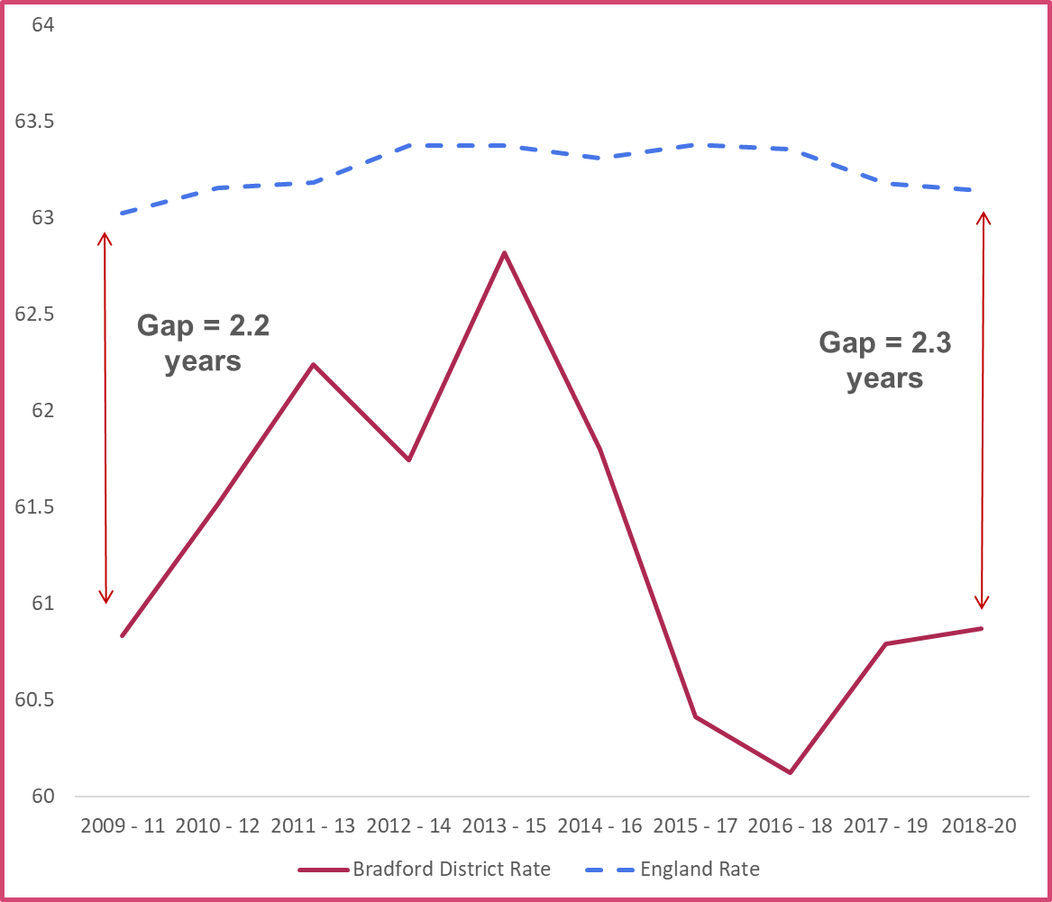
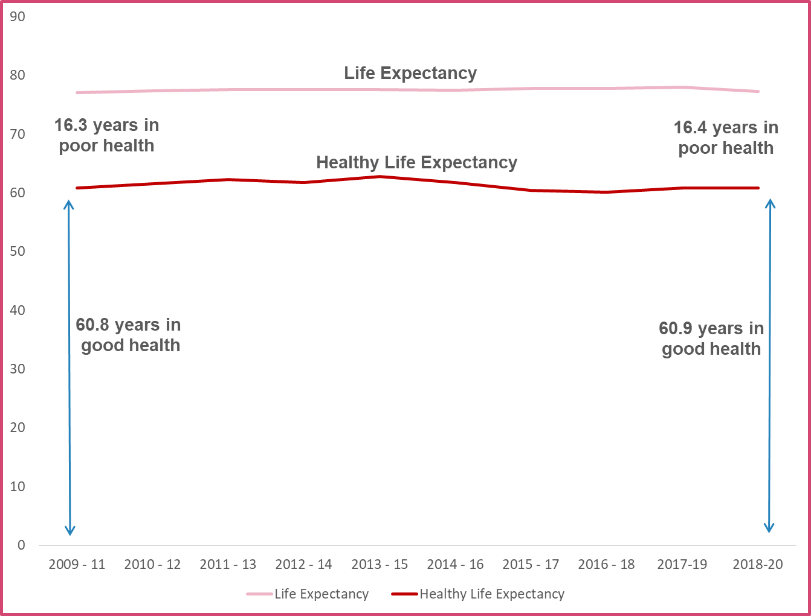
Health Life Expectancy (Males)
The 2018-20 healthy life expectancy for males, in Bradford District, has slightly increased to 60.9 years
The 2018-20 gap between Bradford District and England is 2.3 years, which has widened when compared to 2009-11. However, the gap has narrowed from the 2016-18 gap (3.2 years)
As healthy life expectancy has increased and life expectancy has risen, a male born in Bradford District can now expect to live 16.4 years in ‘poor health’
This is similar to 2009-11 when a male could expect to live 16.3 years in ‘poor health’

Slide 6
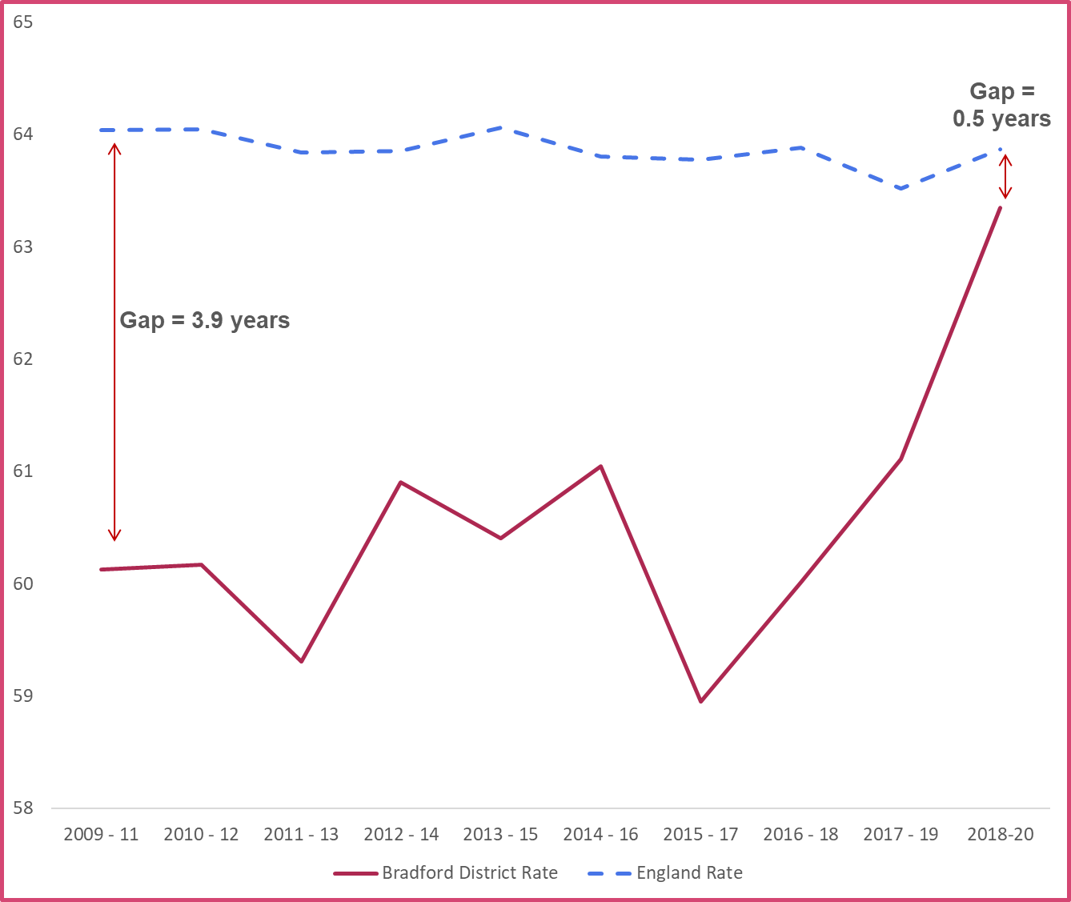
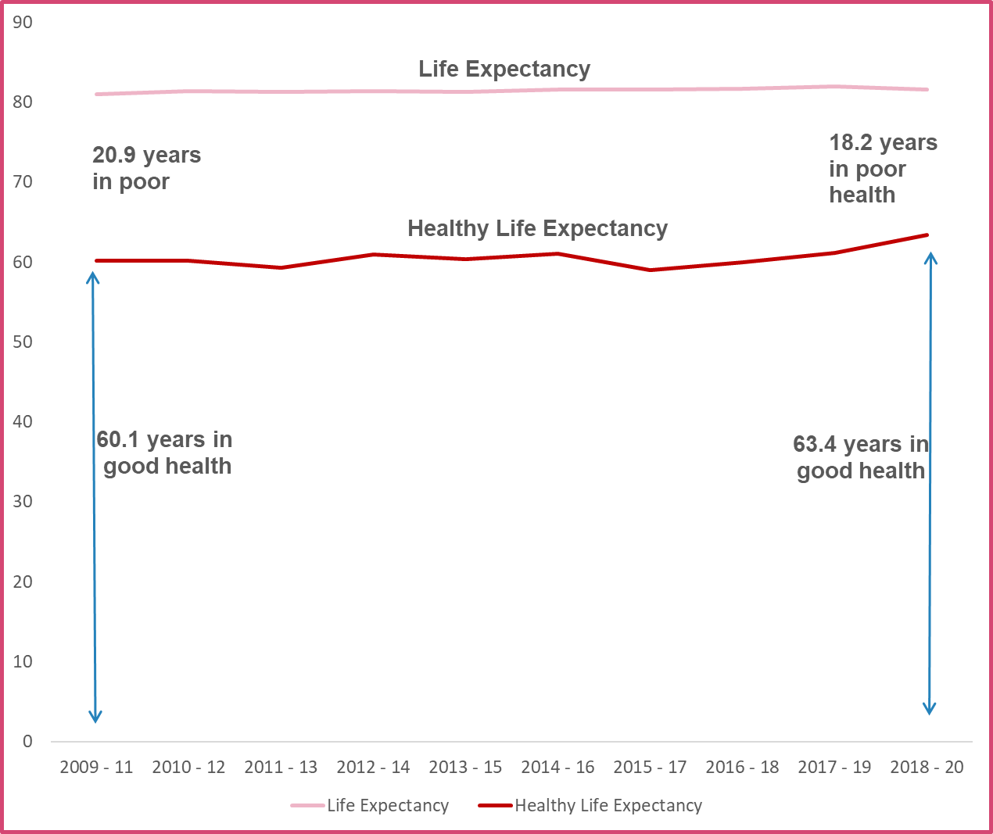
Healthy Life Expectancy (Females)
The 2018-20 healthy life expectancy for in Bradford District, has increased to 63.4 years
The 2018-20 gap between Bradford District and England is 0.5 years, which has significantly narrowed when compared to 2009-11 females
As healthy life expectancy has increased and life expectancy risen, a female born in Bradford District can now expect to live 18.2 years in ‘poor health’
This is better than 2009-11 when a female could expect to live 20.9 years in ‘poor health’

Slide 7
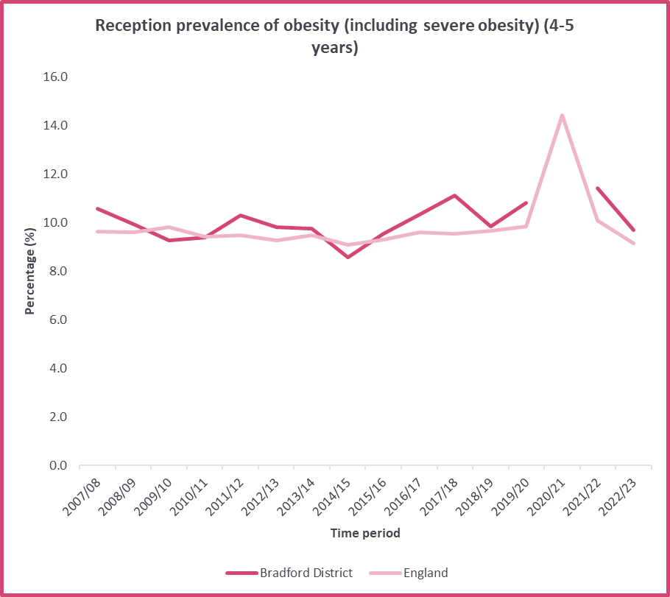
Childhood Obesity: Reception
In 2022/23, 9.7% of reception aged children in Bradford District were classified as being obese or severely obese. This has decreased from the previous year but is slightly higher than England.
The gap between Bradford District and England is currently 0.5 percentage points.
Almost 1 in 10 children aged 4-5 were classified as obese or severely obese in Bradford District in 2022/23
It should be noted that data is unavailable for Bradford District for the period 2020/21.

Slide 8
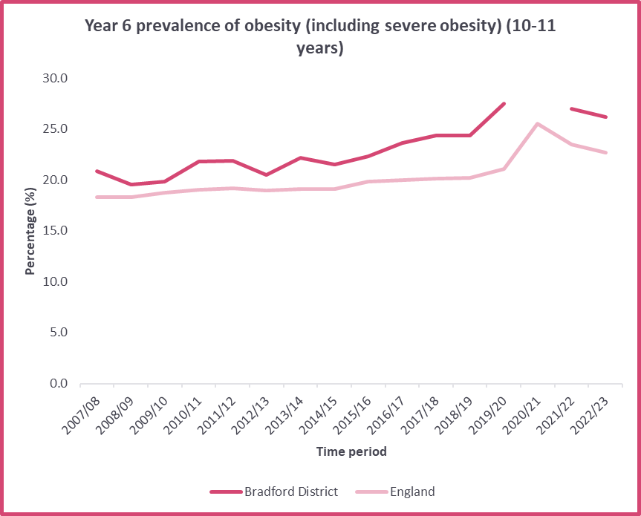
Childhood Obesity: Year 6
In 2022/23, 26.1% of children in year 6 in Bradford District were classified as obese or severely obese. This is a decrease from the previous year, but remains significantly higher than England.
The gap between Bradford District and England is currently 3.4 percentage points.
Over a quarter of children aged 10-11 in Bradford District were classified as obese or severely obese in 2022/23
It should be noted that data is unavailable for Bradford District for the period 2020/21.

Slide 9
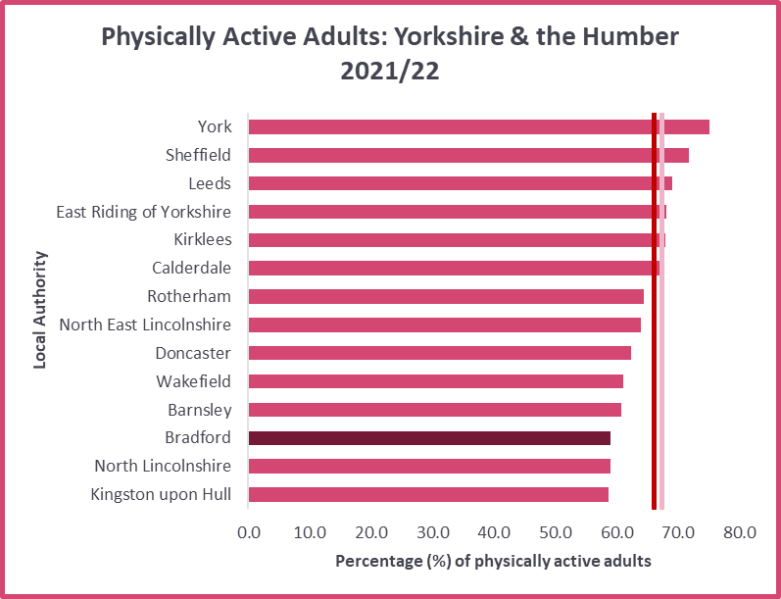
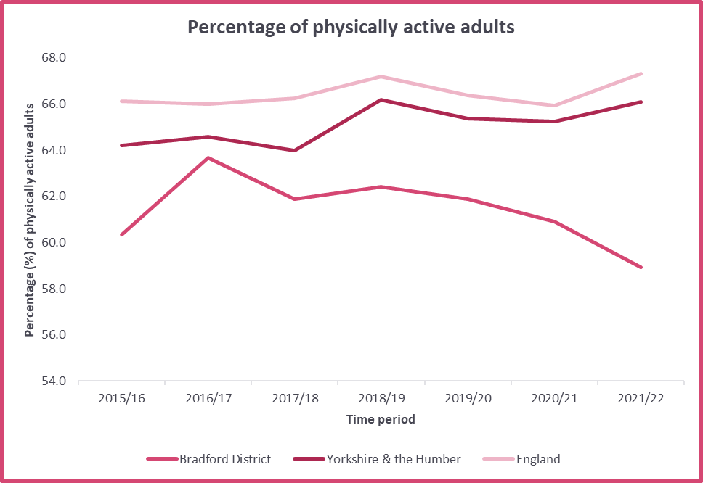
Physically Active Adults
The proportion of adults classed as physically active in Bradford District started to decline in 2018/19 and further declined in 2021/22 to 58.9%.
Where Bradford District has experienced a steady decline the proportion of physically active adults, the regional and national averages are showing to be increasing slightly.
The proportion of physically active adults in Bradford District remains significantly lower than both the regional and national averages.
Bradford District has the third lowest proportion of physically active adults in Yorkshire & the Humber.

Slide 10
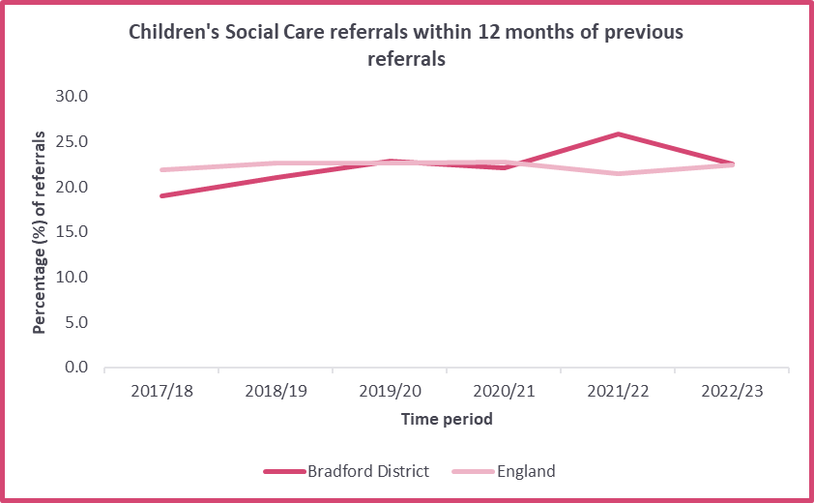
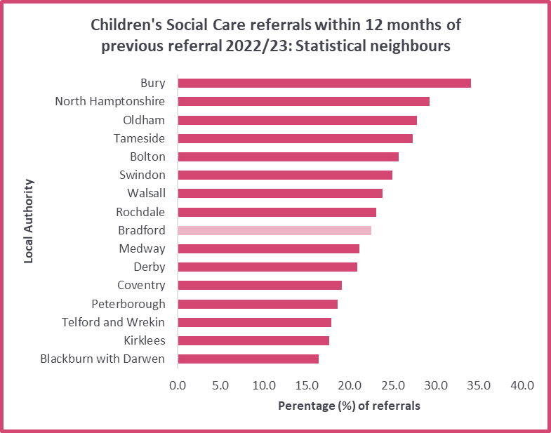
Referrals to Children’s Social Care
In 2022/23, 22.5% of Children’s Social Care referrals in Bradford District were made within 12 months of the previous referral. This is lower than the previous year and is a similar rate to England.
Bradford District sits mid-table when compared to statistical neighbours, slightly below the median of 22.8%.

Slide 11
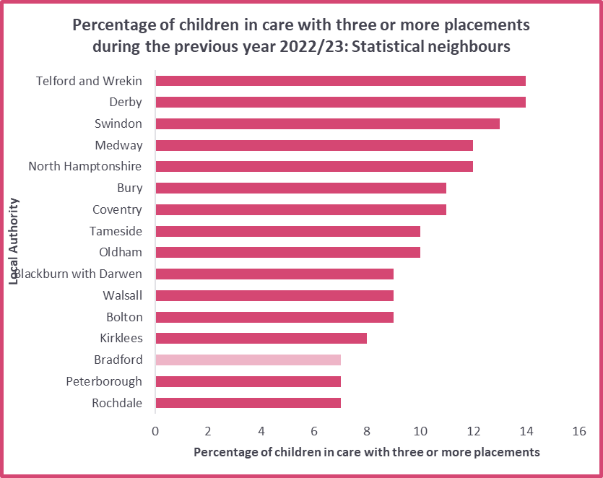
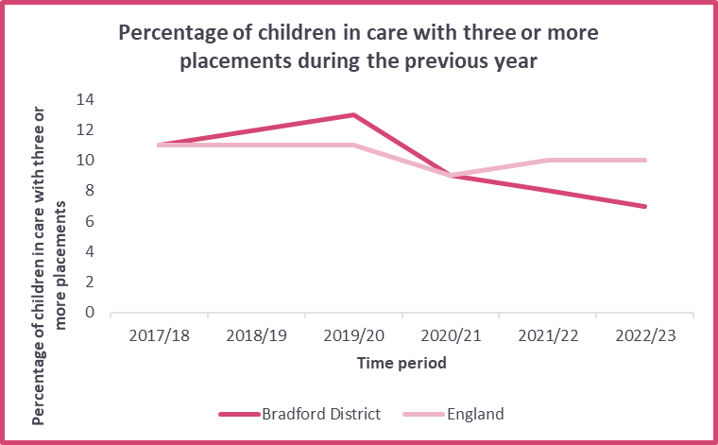
Children in Care
In 2022/23, 7% of children in care in Bradford District had three or more placements during the previous year. This is better than previous years and significantly lower than England.
Compared to statistical neighbours, Bradford District has the lowest proportion of children in care with three or more placements during the previous year.

Slide 12
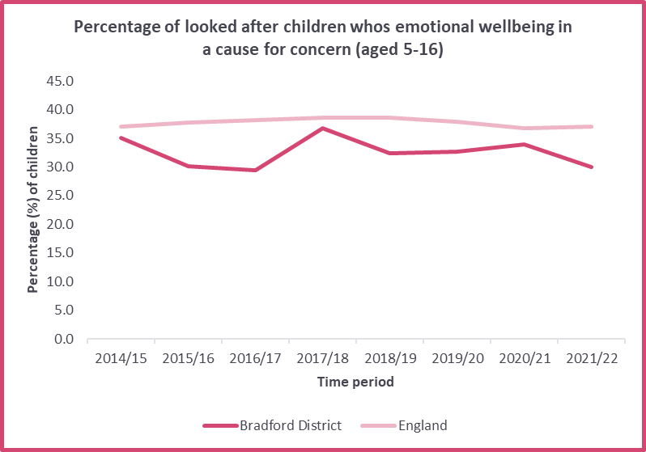
Emotional Wellbeing of Looked After Children
In 2022/23, the proportion of looked after children in Bradford District whose emotional wellbeing in a cause for concern was 30%. This is lower than the previous year and significantly lower than England.

Slide 13
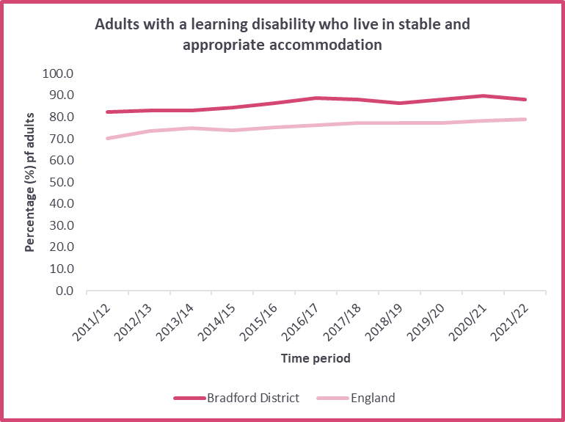
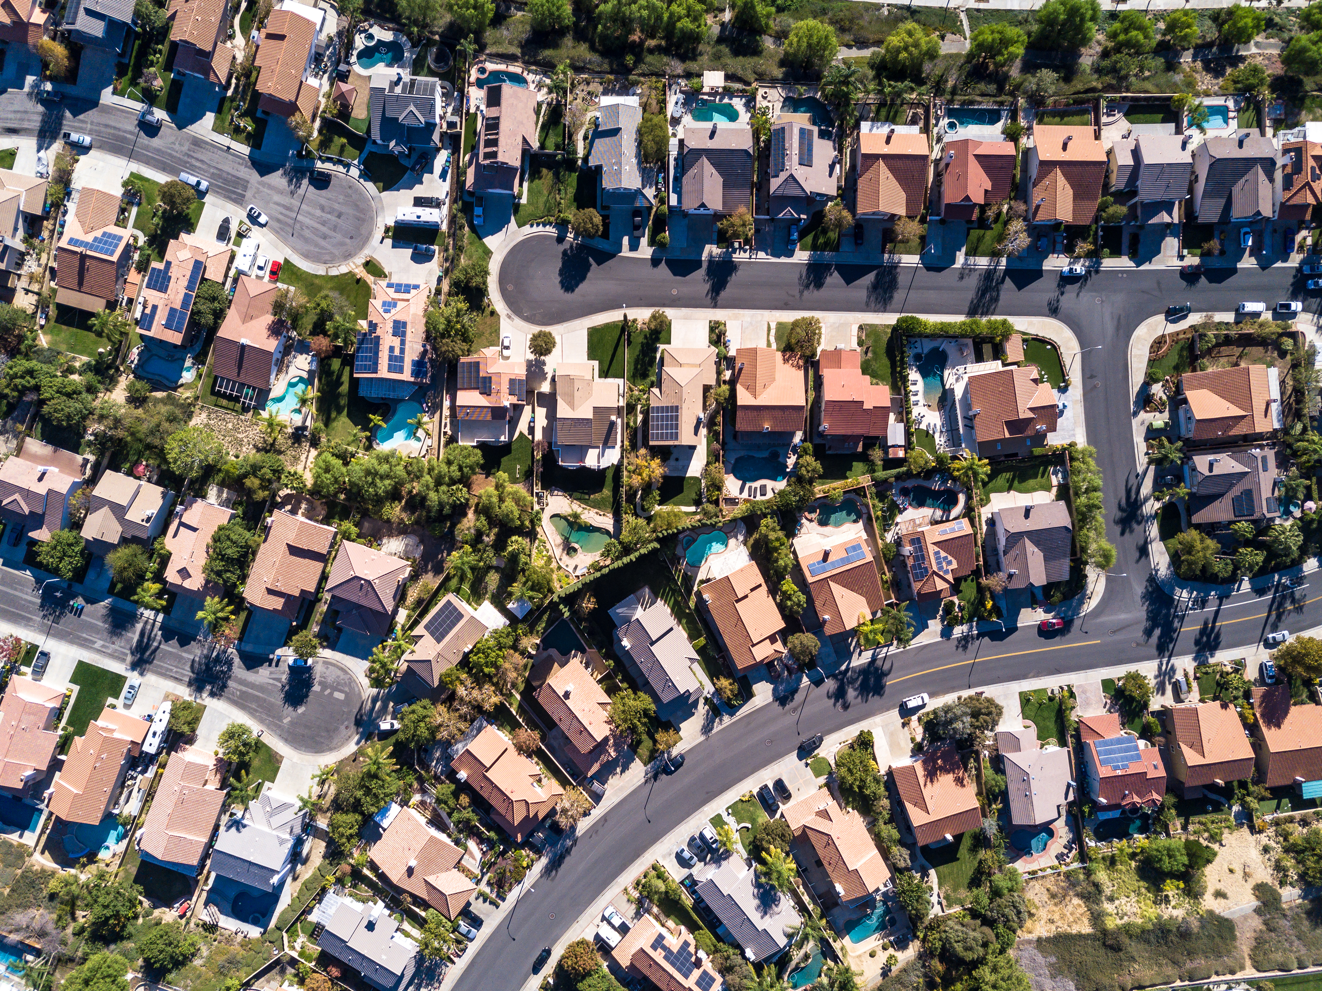
Accommodation for People with Learning Disabilities
Maintaining settled accommodation and providing social care in this environment promotes personalisation and quality of life, prevents the need to readmit people into hospital or more costly residential care and ensures a positive experience of social care (Office for Health Improvement & Disparities).
In Bradford District in 2021/22, 88.1% of people with learning disabilities were living in stable and appropriate accommodation. This is better than England and has remained higher than England for the past 10 years.

Slide 14
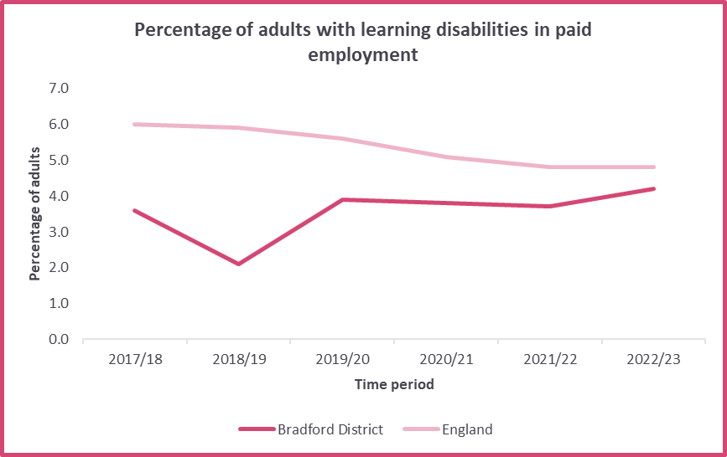
Adults with Learning Disabilities in Paid Employment
In 2022/23, 4.2% of adults with learning disabilities in Bradford District were in paid employment. This is higher than the previous year.
Bradford District has a lower proportion than England by 0.6 percentage points. However, where Bradford District is indicating an increase, England remains the same from the previous year, and shows a decrease from the years prior to this.

Slide 15
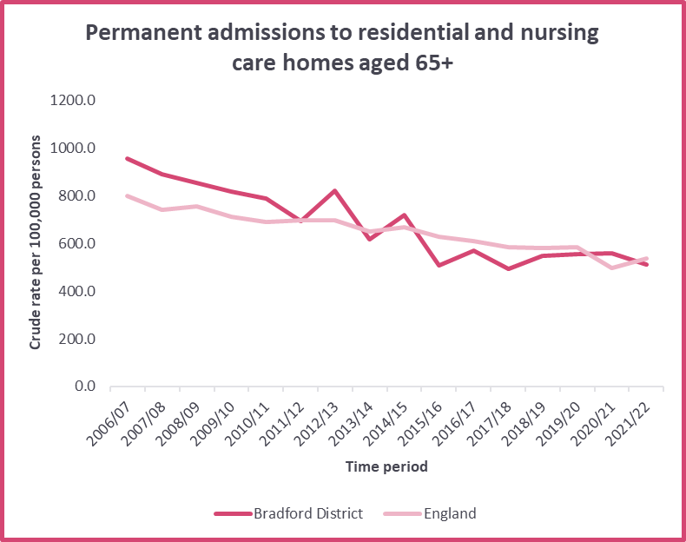
Permanent Admissions to Care Homes (65+)
In Bradford District in 2021/22, the crude rate for permanent admissions to residential and nursing care homes was 512, which is better than the previous year.
The rate for Bradford is lower than the rate for England.

